Slide 1
HR Analytics Project
Presented By Prateek Sood

Slide 2
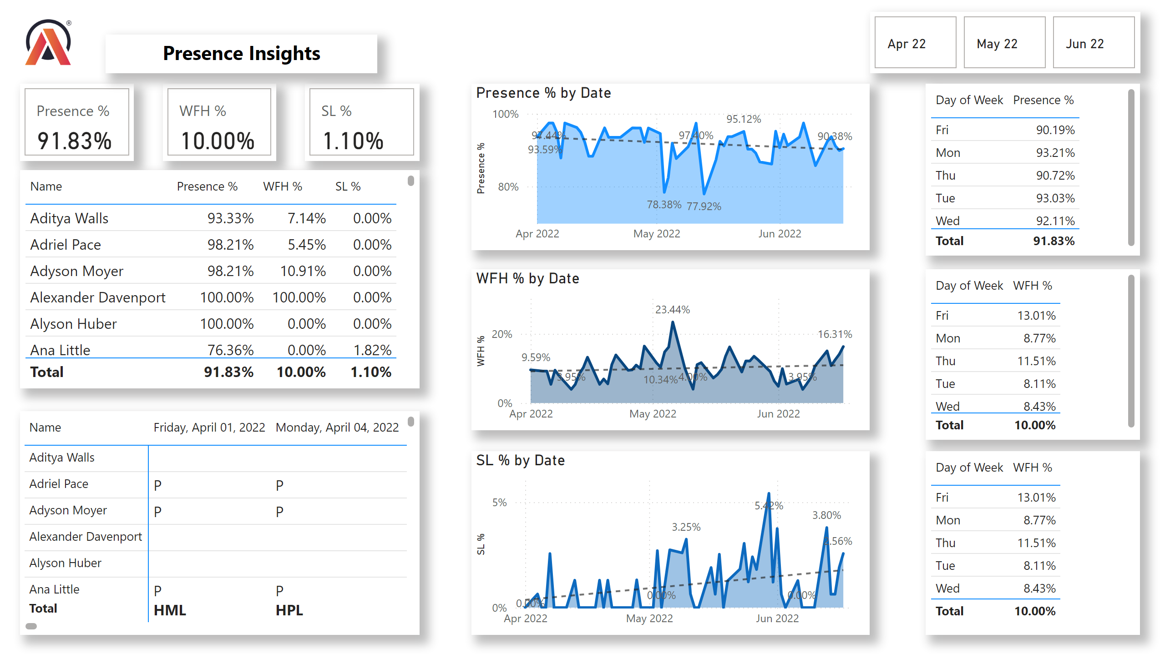
HR Analytics
Notes:
cardVisual
No alt text provided
cardVisual
No alt text provided
advancedSlicerVisual
No alt text provided
cardVisual
No alt text provided
tableEx
No alt text provided
textbox
No alt text provided
pivotTable
No alt text provided
areaChart
No alt text provided
areaChart
No alt text provided
areaChart
No alt text provided
tableEx
No alt text provided
tableEx
No alt text provided
tableEx
No alt text provided
image
No alt text provided

